Slide 1
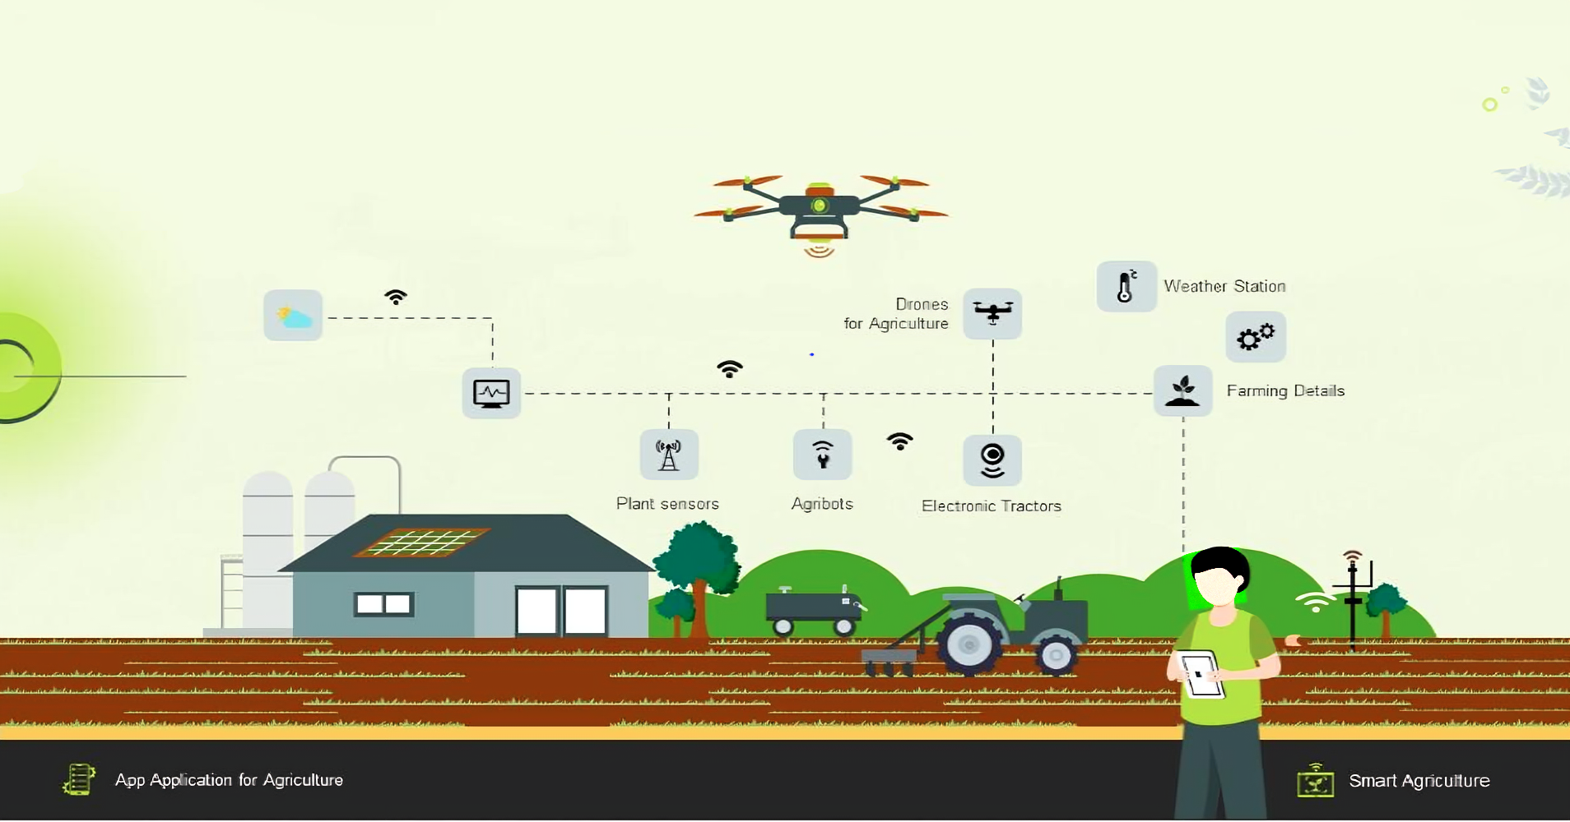
Agro-Genesis: Cultivating Tomorrow's Harvest with Precision Intelligence

Slide 2

Meet Our Team:
K. Lokesh Surya Prakash (22PA1A0576)
K. T.Narasimha Naidu (22PA1A0577)
K. Vishnu Vardhan (22PA1A0578)
Under the Mentorship of:
Ms. R. Hemalatha

Slide 3

Contents :
Problem Statement
Methodology
Sample Data
Literature
Future Aspects
Conclusion

Slide 4

Problem Statement:
In contemporary agriculture, the cultivation of even small plots of land has grow to be more and more risky because of elements past farmers manage, such as unpredictable weather and fluctuating marketplace conditions. To cope with this mission, there's a critical need to revolutionize traditional farming techniques via leveraging predictive technology and records analytics. By offering farmers with early insights into soil fertility, water availability, and marketplace traits, we are able to empower them to make
knowledgeable decisions and mitigate capability losses, ultimately ensuring the
sustainability and profitability of agricultural operations.

Slide 5



Abstract
Our transformative revolution in agriculture harnesses modern sensor technology to empower farmers with foresight, safeguarding against losses and optimizing resource utilization. Through dynamic soil analysis and predictive analytics, our platform gives tailored hints, fostering sustainable practices and maximizing profitability.
Introduction
Farming is getting harder with all the changes happening. We want to help by using wireless sensors. These sensors check the soil to predict its fertility, how much water it has, and what the climate is like. They also help figure out the cost and profit of producing crops and suggest which crops are best to grow. Plus, they predict what fertilizers to use. This helps farmers plan better and use resources smarter, so they can deal with problems better.

Slide 6
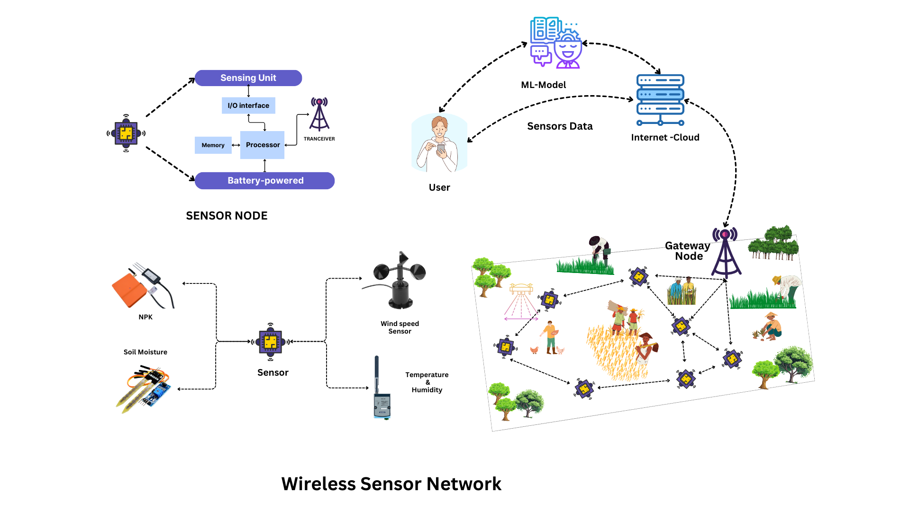
Model Architecture

Slide 7
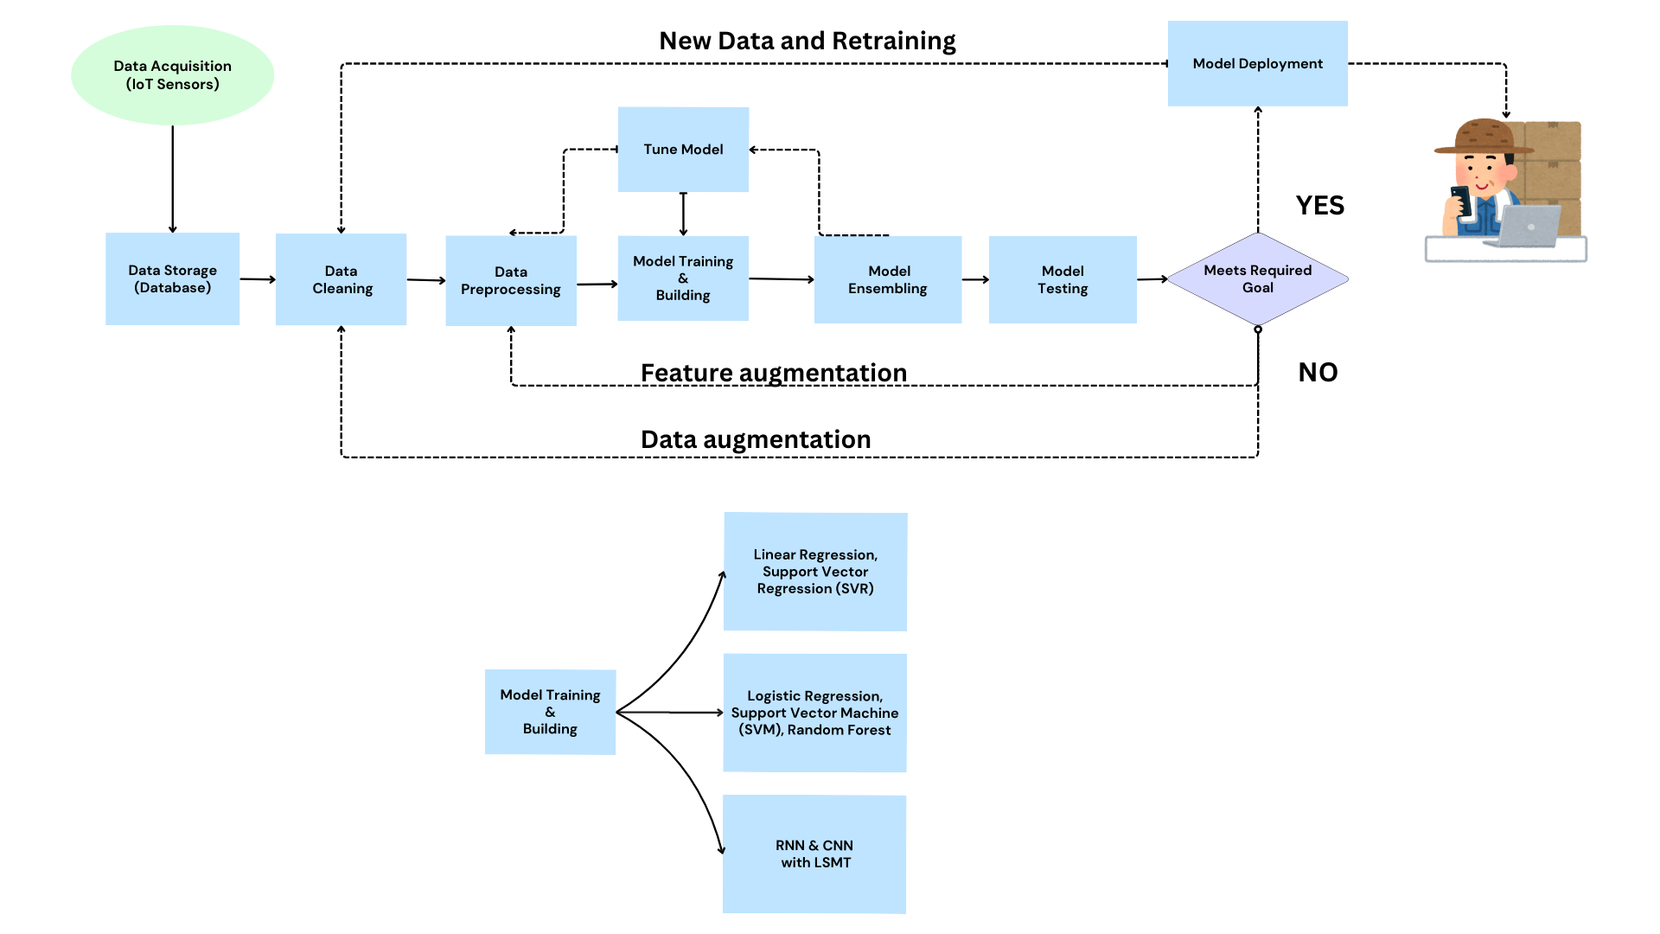
ML Block Diagram

Slide 8
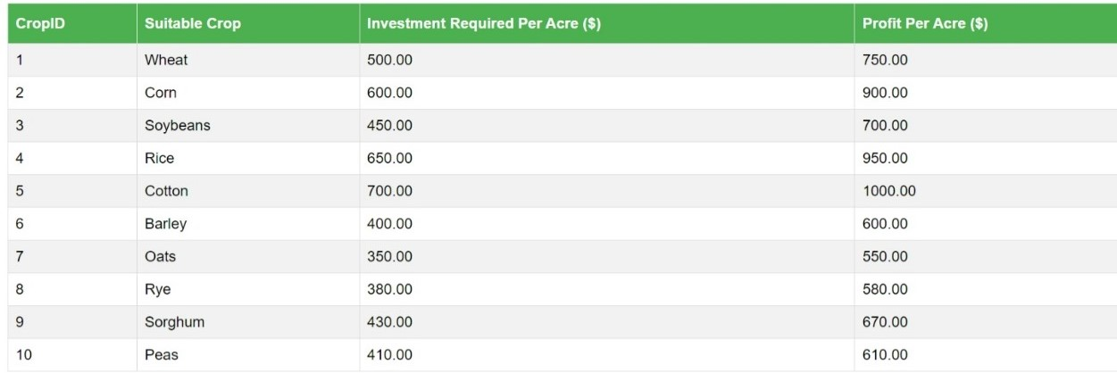
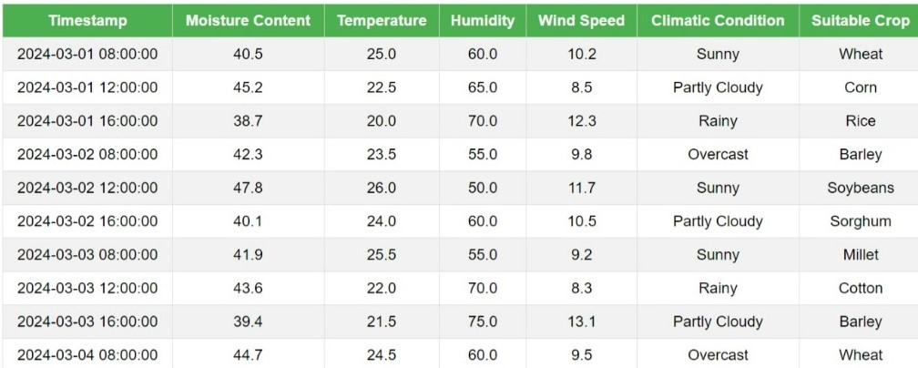
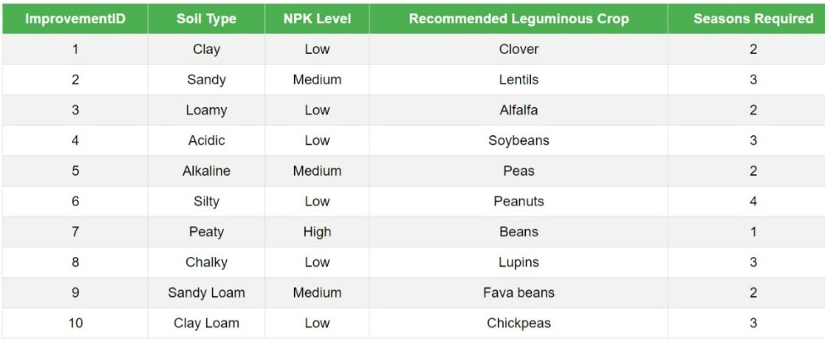
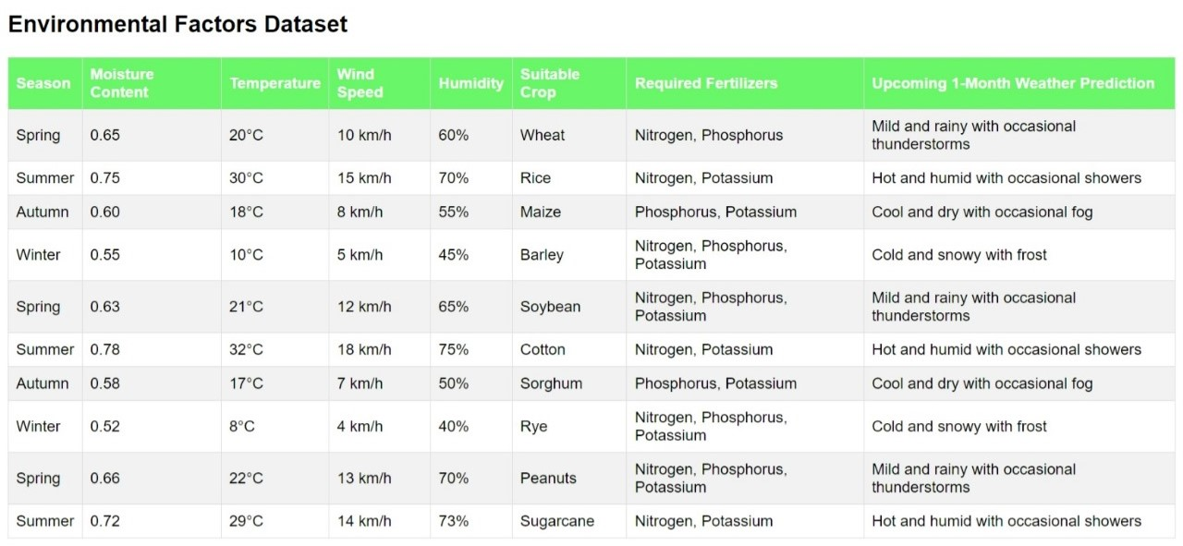
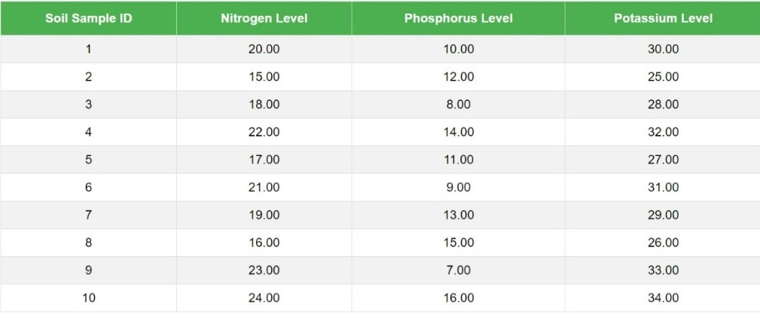
Sample Data
Sample-1: Production Data
Sample-2: Current Weather Data
Sample-3: Soil Fertility Data
Sample-4: Environmental Factors Data
Sample-5: NPK Values Data

Slide 9
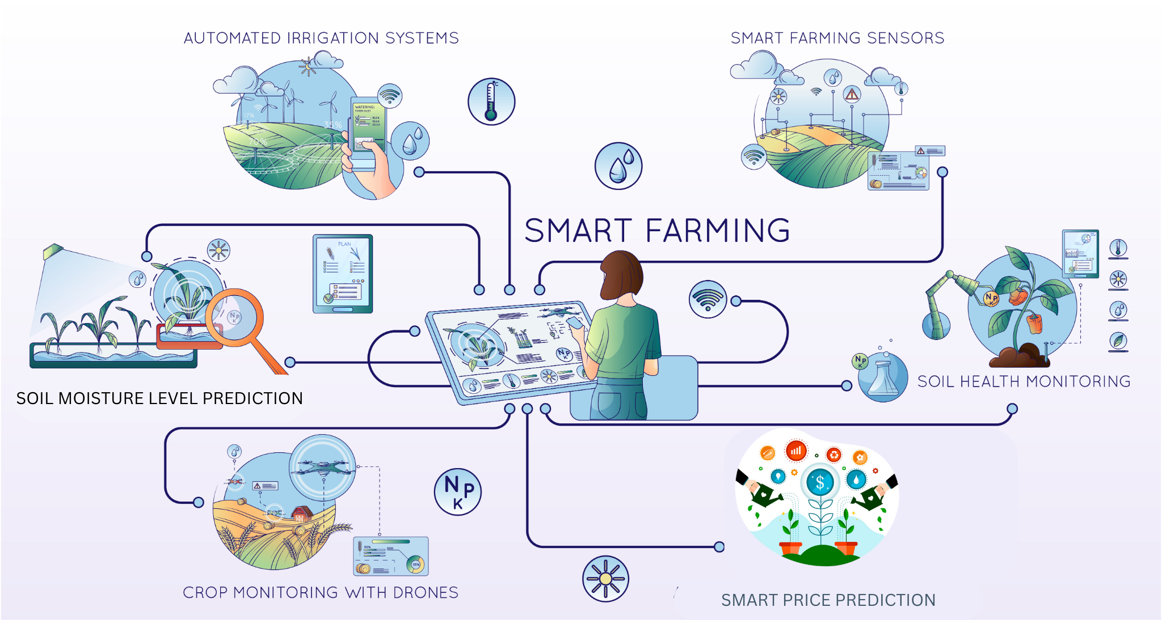
Outlook

Slide 10

Literature :
Before Implementation:
Limited insight and anticipation: Traditional methods lack proactive risk assessment.
Vulnerability to losses: Farmers struggle with unpredictable weather and market conditions.
Reduced yields and profitability: Inadequate data leads to suboptimal resource management.
Inefficient fertilizer usage: Lack of insights leads to improper fertilizer application, impacting soil health and crop yields.
After Implementation:
Empowered decision-making: Sensor tech and analytics offer real-time insights.
Optimized resource utilization: Predictive analytics optimize resource allocation.
Market insights and profit maximization: Farmers capitalize on market trends.
Paradigm shift in agriculture: Bridging traditional wisdom with modern innovation.
Efficient fertilizer usage: Data-driven recommendations improve fertilizer application, enhancing soil health and maximizing crop yields.

Slide 11


Future Aspects:
Crop bioengineering for resilience
enhancement.
Blockchain for transparent supply chains.
Global platform expansion for diverse markets.
AI integration for advanced sensors.
Crop genetic modification for productivity.
Sustainable farming through modern tech.

Slide 12
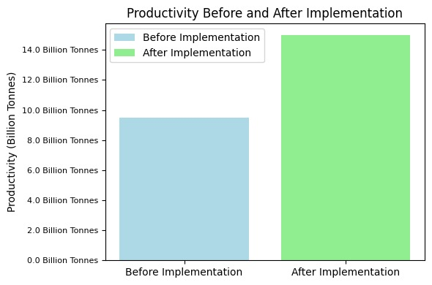
Future Analysis

Slide 13

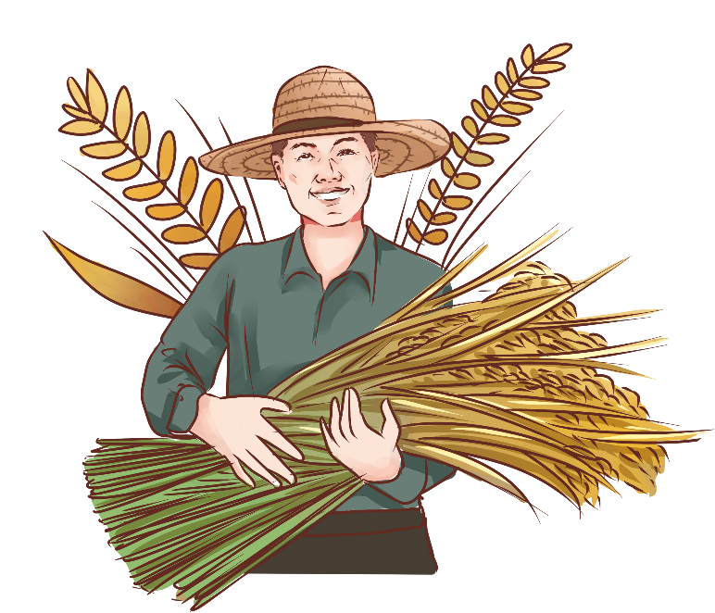

Conclusion
Our agricultural modernization initiative empowers farmers with actionable insights and predictive analytics. Through advanced sensor technologies and algorithms, we optimize resource allocation and mitigate risks. By bridging tradition with innovation, we pave the path for sustainable farming practices, securing a resilient future for food production.

Slide 14


(Cultivating Tomorrow's Harvest with Precision Intelligence)
Thank you

